Slide 1
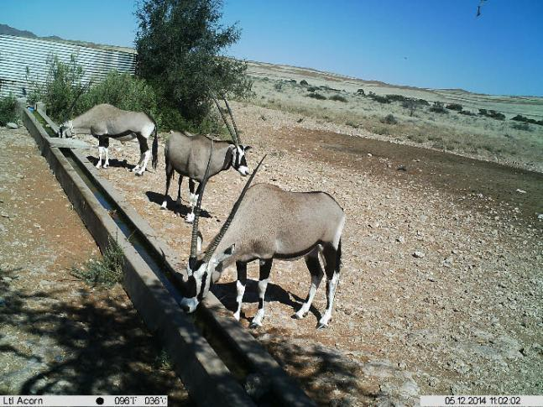
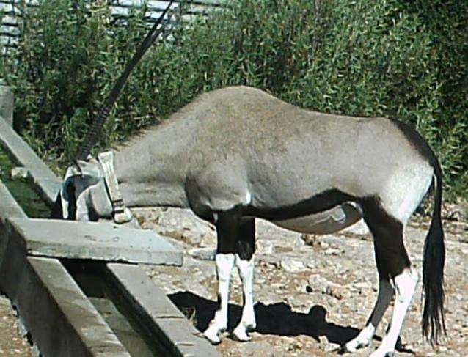
Observations on the movements and home ranges of Hartmann’s Mountain Zebras and Oryx in the Greater Sossusvlei-Namib Landscape Based on a report by John Mendelsohn (RAISON)

Slide 2
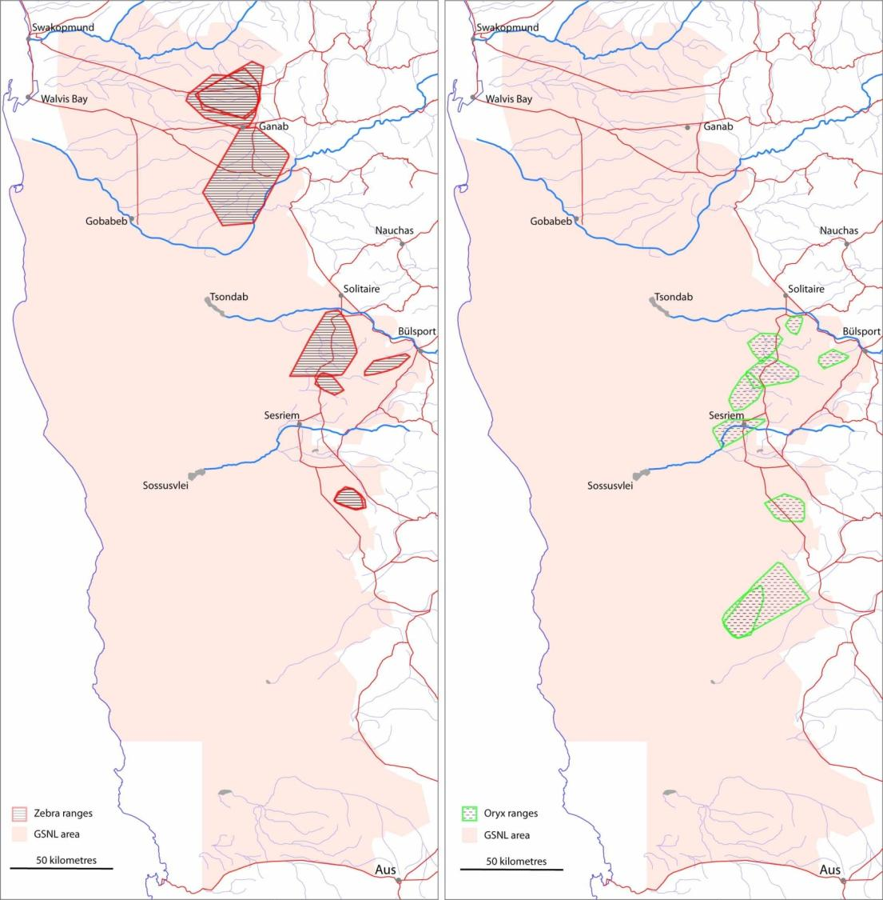
The location and home ranges to date (after 7 months tracking) of 9 Mountain Zebra and 9 Oryx in the central Namib
Mountain Zebra
Oryx / Gemsbok

Slide 3
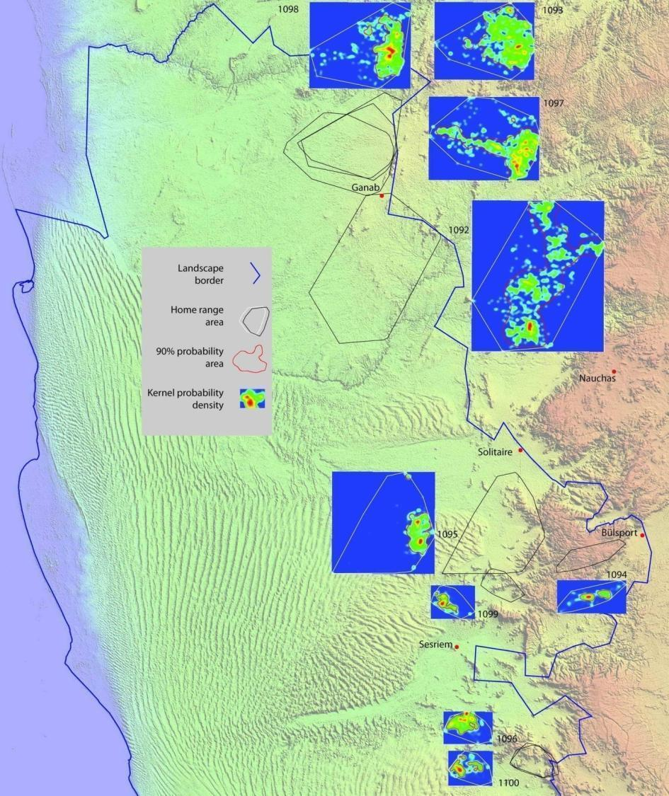
Location of 9 Mountain Zebra in the central Namib fitted with GPS tracking devices and their home ranges to date
Tracking devices fitted 22 & 23 November 2013
Numbers refer to the GPS transmitter code numbers
Location of animals recorded every 5 hours
Data analysed up to 26 June 2014, i.e. 7 months
Over 1,000 locations for each animal

Slide 4
Location of 9 Oryx in the central Namib fitted with GPS tracking devices and their home ranges to date
Tracking devices fitted 22 & 23 November 2013
Numbers refer to the GPS transmitter code numbers
Location of animals recorded every 5 hours
Data analysed up to 26 June 2014, i.e. 7 months
Over 1,000 locations for each animal

Slide 5
Summary information: Hartmann’s Mountain Zebra
Transmitter number | Sex | Area | Home range (ha) | 90% density (ha) | Average daily distance (km)
1092 | ♀ | Ganab | 130,975 | 58,473 | 10.7
1093 | ♀ | Ganab | 50,547 | 28,082 | 10.9
1094 | ♂ | Tsondab - Naukl | 11,925 | 1,821 | 3.9
1095 | ♂ | Tsondab - Naukl | 69,058 | 8,053 | 7.6
1096 | ♂ | NamibRand | 11,208 | 4,562 | 5.7
1097 | ♂ | Ganab | 68,045 | 22,499 | 10.6
1098 | ♂ | Ganab | 58,948 | 14,733 | 9.2
1099 | ♀ | Tsondab - Naukl | 9,011 | 1,757 | 5.7
1100 | ♀ | NamibRand | 10,599 | 2,324 | 5.2
Average |  |  | 46,702 | 15,812 | 7.7

Slide 6
Summary information: Oryx
Transmitter number | Sex | Area | Home range (ha) | 90% density (ha) | Average daily distance (km)
1101 | ♀ | Tsondab - Naukl | 8,335 | 3,493 | 2.5
1102 | ♀ | Tsondab - Naukl | 26,637 | 15,488 | 5.4
1103 | ♀ | Tsondab - Naukl | 15,568 | 3,114 | 6.2
1104 | ♀ | Sesriem - Sossus | 20,046 | 6,382 | 5.1
1105 | ♀ | Sesriem - Sossus | 20,026 | 6,569 | 5.9
1106 | ♀ | Sesriem - Sossus | 5,419 | 2,901 | 5.2
1107 | ♀ | NamibRand | 19,877 | 7,033 | 6.5
1108 | ♀ | NamibRand | 31,848 | 7,936 | 6.0
1109 | ♀ | NamibRand | 75,051 | 19,147 | 6.4
Average |  |  | 24,756 | 8,007 | 5.5

Slide 7
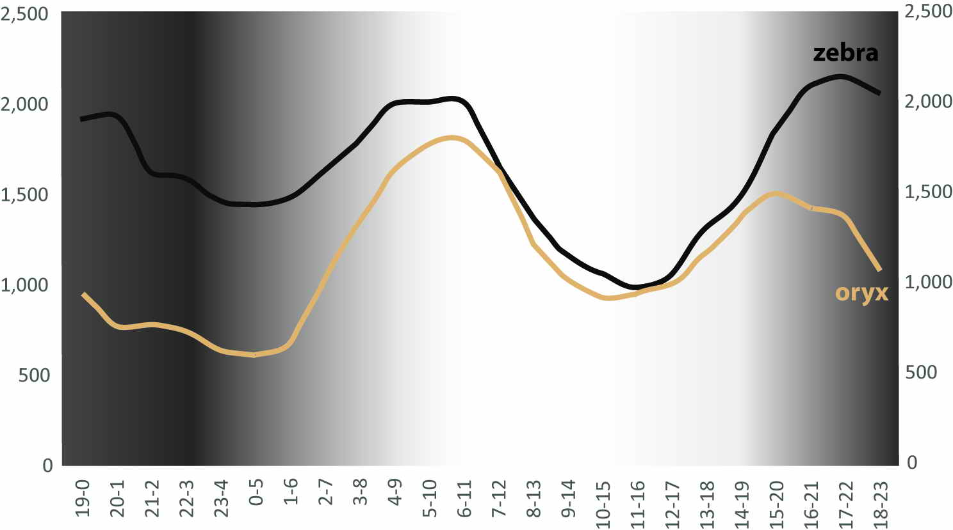
Average distances (m) walked per 5-hour periods by Hartmann’s Mountain Zebra and Oryx

Slide 8
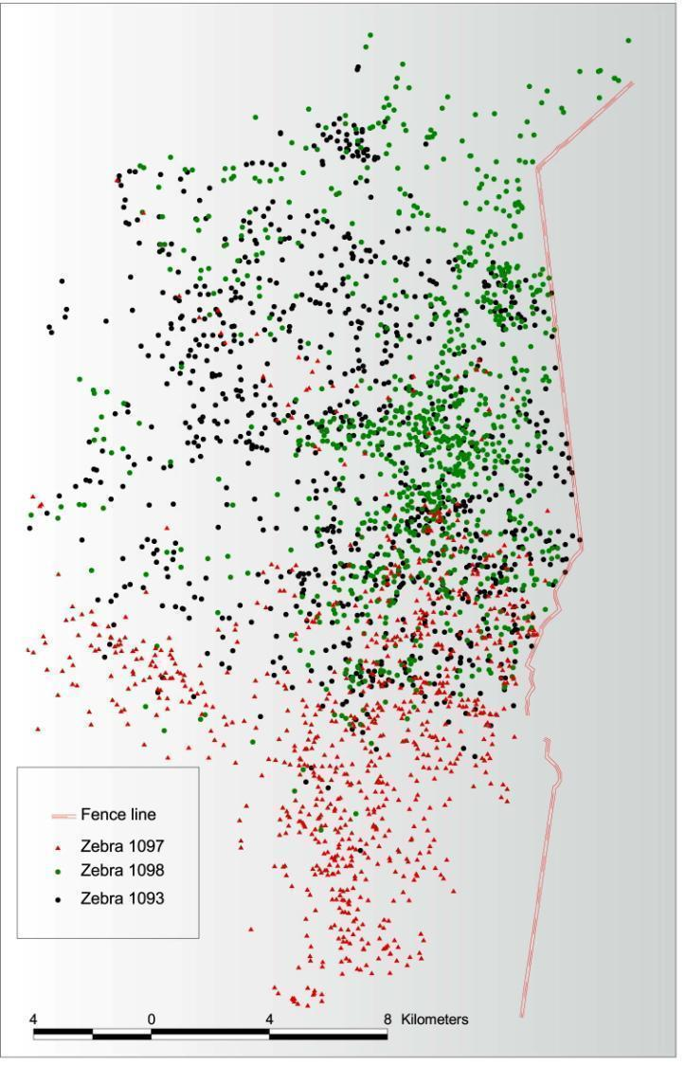
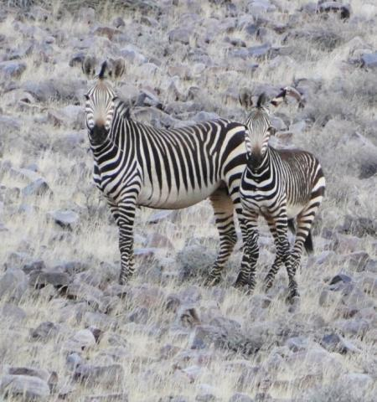
Distributions of 3 zebras in the Ganab area showing how their ranges are restricted by the fence bordering the Namib-Naukluft Park

Slide 9
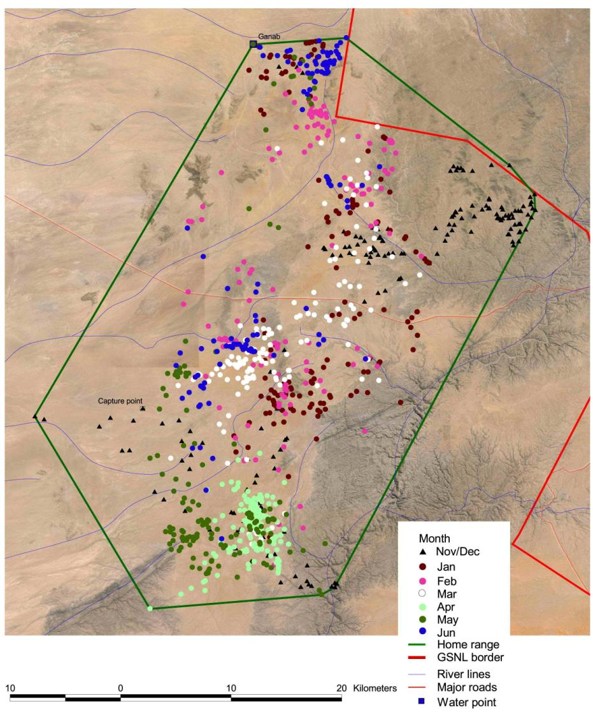
Locations colour-coded by month of zebra 1092, a female in the Ganab area with the largest home range to date (131,000 ha)
Home ranges determined using the “minimum convex polygon” method

Slide 10
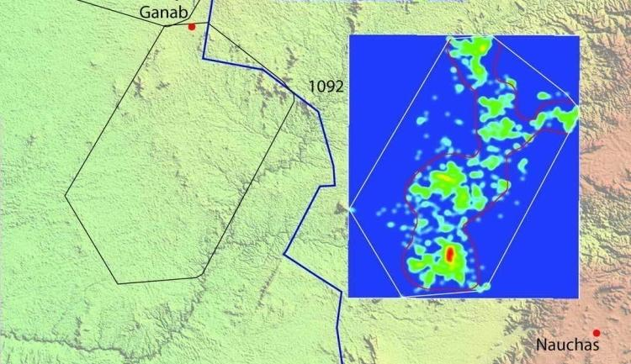
Locations of zebra 1092 analyzed for 90% intensity of landscape use (inside the red line) and colour-coded to show intensity of use

Slide 11
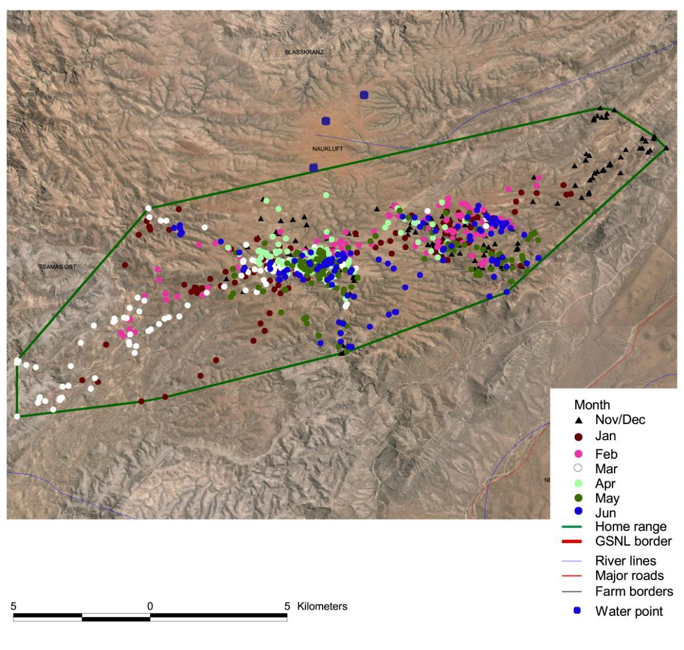
Zebra 1094 spent all its time in the Naukluft Mountains. One of the smallest ranges (11,925 ha and 1,821 ha core range). Did not appear to visit the 3 nearest water points.

Slide 12
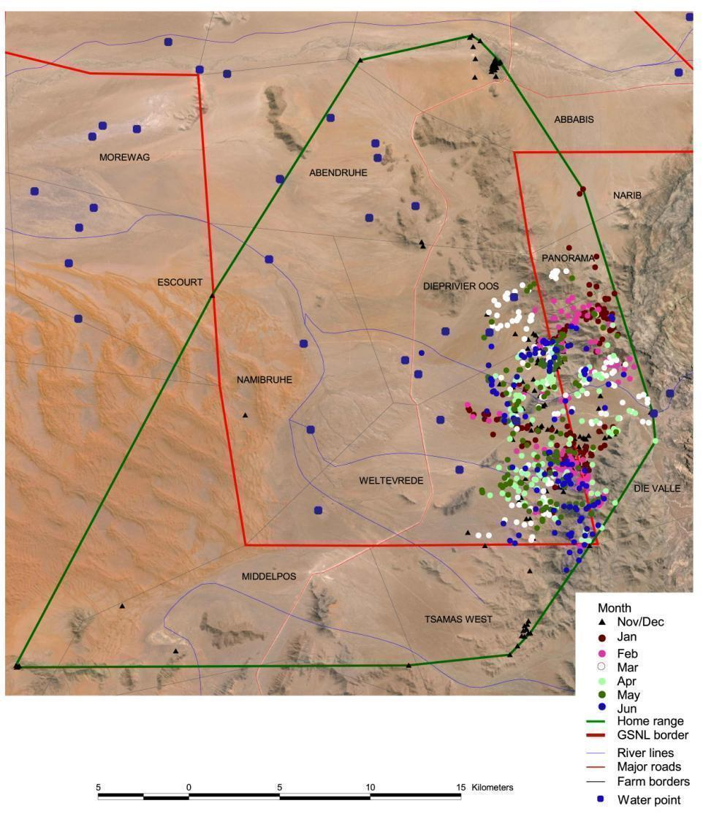
Zebra 1095 spent Jan – June in the adjacent plains and foothills of the Tsondab Valley & Naukluft but in Nov & Dec had ranged far to north & west, even into dunes. On 9th Dec between 13h30 & 18h30 it covered at least 25.6 km

Slide 13
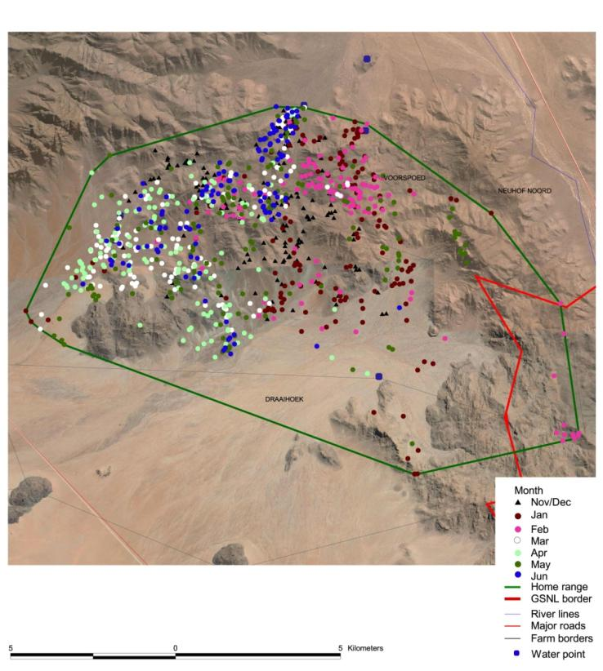
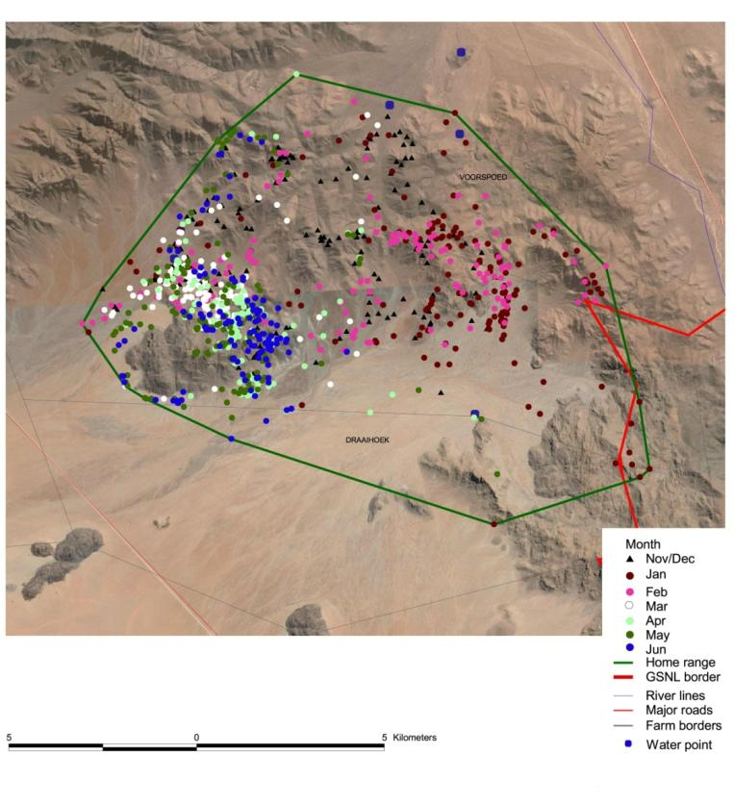
Male zebra 1096 (left) and female zebra 1100 (right) occupy the same small area (11,000 & 10,600 ha respectively) of hills in the north-east of NamibRand

Slide 14
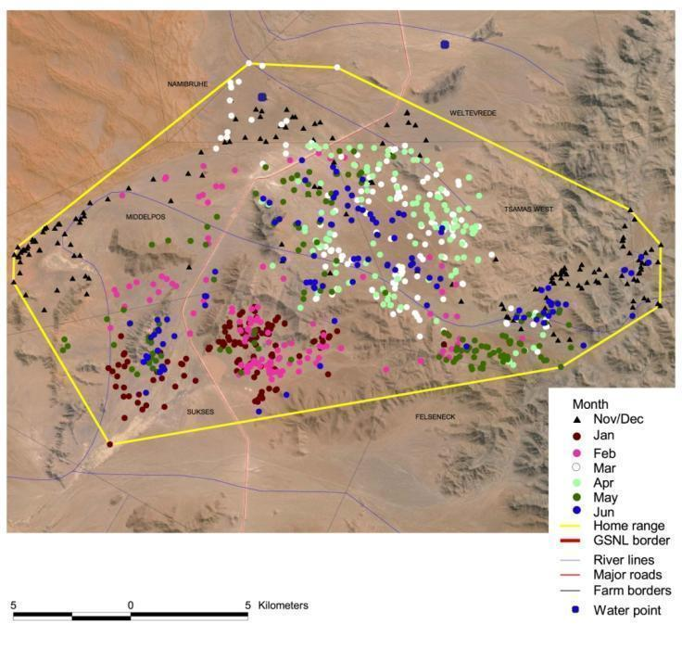
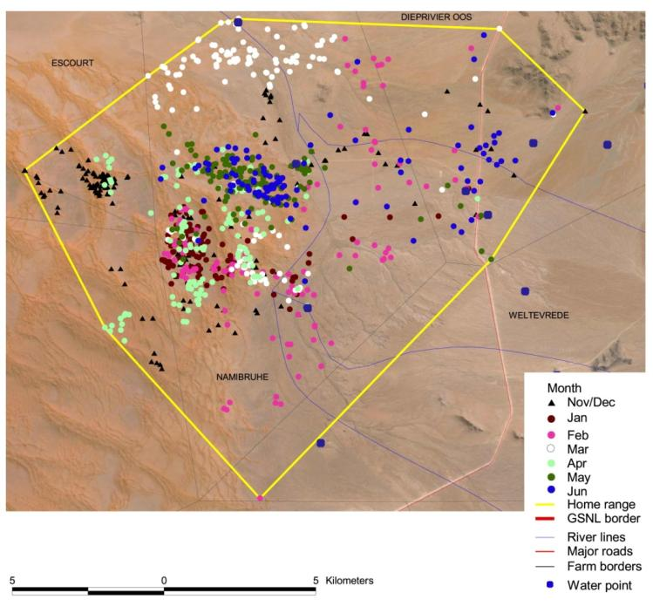
Oryx 1102 & 1103 in the Tsondab area west of the Naukluft mountains. Note the clusters of dots, suggesting that the animals stay in a relatively small area for a while, then move to another area.

Slide 15
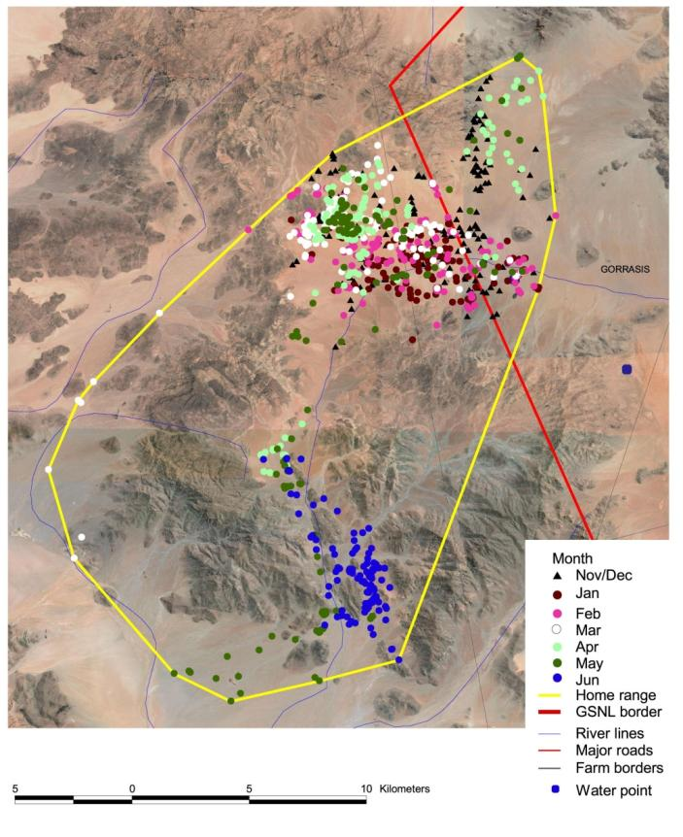
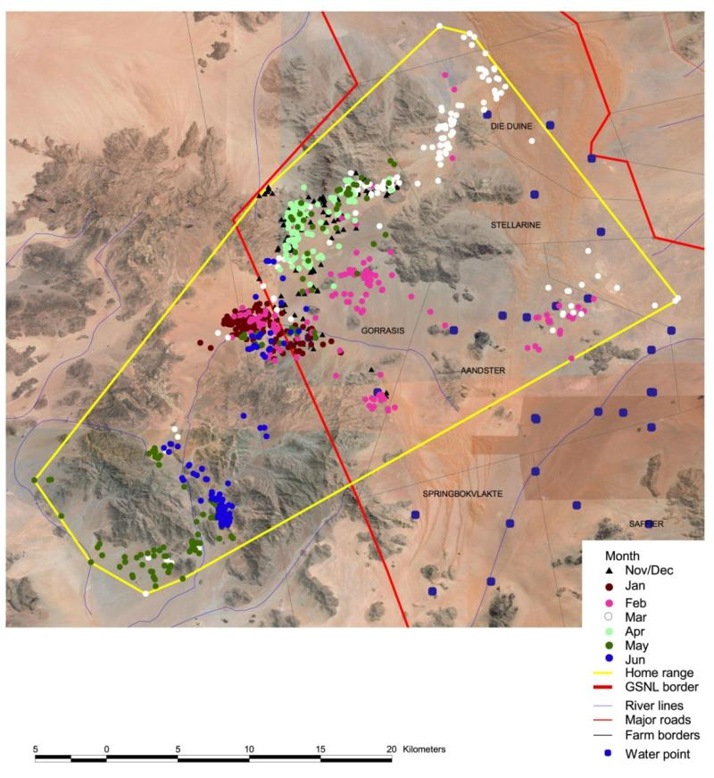
Oryx 1108 & 1109 in the NamibRand area had the largest home ranges (31,800 & 75,000 ha respectively) – but focused in discrete widely spread areas.

Slide 16
Suggested next steps
Repeat the analysis after 12 months of data collection
Analyse for seasonality
Start to explore “drivers” of movement and range use
Analyse for times spent on plains versus hills / mountains
Look in detail at movements in areas where boundary fencing has been removed
Bring in UNAM / Polytech students to work on the repeat analysis
Find MSc and/or PhD students to carry out further in-depth analysis
Explore possibility of attaching GPS collars to Springbok
Other ideas?

